Slide 1


Slide 2
What is the purpose of this task?
To understand the concept “Labour Market Information”
What will you learn from this task?
To define what LMI is
To identify sources of LMI
To carry out a small scale research activity using 1 company and deliver a presentation
To produce a personal action plan using LMI
You will need
Internet access
Local maps
Whiteboard / flip chart
Personal action plan sheets 1 and 2

Slide 3
Task: What is LMI?
As a whole group do you know what LMI is? It is Labour Market Information - information about the number and type of companies and employment opportunities in your area
Discuss where would you look for information about LMI Sources include your careers library, local press, the internet, business directories, libraries, people you know, job adverts.
Can you think of any new businesses opening up locally or any that have closed down?

Slide 4
Task: Research one company
Choose one of your two identified companies, it should be one with a website
Using the website or information available to download from it – find out what you can about this company
Prepare a short presentation (no more than 5 minutes) to deliver to others covering:
  What it does
  Where it is (one site or many)
  How big it is (how many people it employs)
  Are they recruiting for people now and if so, what type of job?
  Can you pick out key messages about the companies values, what it stands for?
  Can you tell the difference between advertising (what is designed to make you feel good about the company) and information (what is fact) on the website?

Slide 5
Task: Personal Action Plan
Complete a personal action plan using the action plan worksheets
Come back to it when you have had time to do some more research

Slide 6
PERSONAL ACTION PLAN
SHEET 1

Slide 7
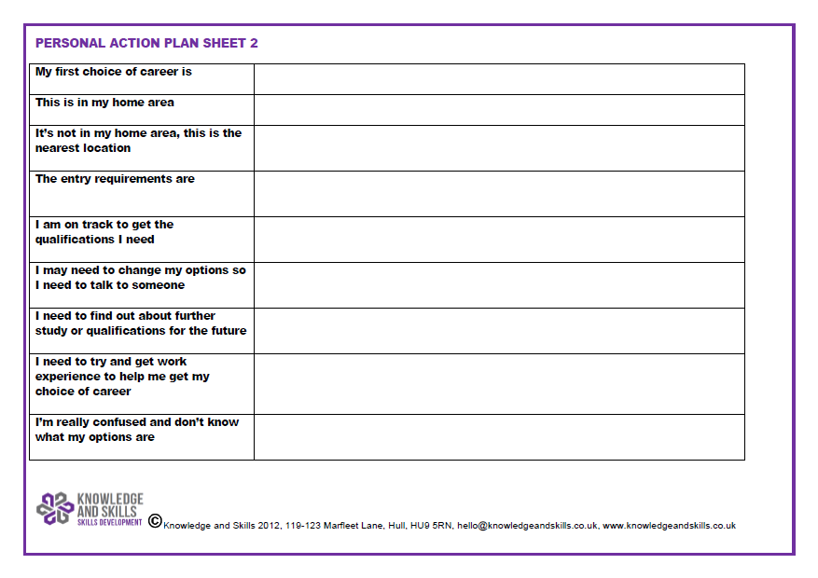

Slide 8
Review
How easy or difficult were these tasks?
Did you think of any new sources of LMI that you didn’t know about before?
How easy or difficult is it to tell the difference between advertising and fact?
How can you find out what a company’s culture or values are and why does this matter?

Slide 9
Extension
If you want to spend longer on this topic…
Carry out a further individual research task. Think of a job that you would really like to do. Using any sources of information available to you find out the following:
Can you do the job where you live now or would you have to travel
Would it mean moving away to live and work elsewhere?
What are the entry requirements?
Do you need to study further or get more qualifications?
What salary can you expect when you start?
Once you are in – what are the opportunities to move up or progress?

